Slide 1
saf.talks
business dinner

Slide 2
UBA + SIEM = SAF

Slide 3
demonstration plan
Practical scenario
Technical part
Using UBA scenario on an near real example of using the module
Basic steps to set up the module
Functional features
Synergy with SAF modules

Slide 4
antifraud
cybersecurity
work
discipline
SAF
UBA
operational efficiency
monitoring
of VIP users
business processes

Slide 5
antifraud
cybersecurity
work
discipline
SAF
UBA
operational efficiency
monitoring
of VIP users
business processes

Slide 6
1. Practical scenario

Slide 11
Live demo

Slide 12
2. Technical part

Slide 13
User Behavior Analytics
basic steps to set up the module
objects
users
administrators
hosts
VIP users
etc.

Slide 14
definition of scoring objects
categories of objects
Inventory
department=="IT department" OR
department=="HR department"
users
department=="IT department" AND
position=="System administrator "
admins
category=="workstation" AND
location==”Dubai"
hosts
IDM
…

Slide 15
Live demo

Slide 16
User Behavior Analytics
basic steps to set up the module
generation object profile
objects
users
administrators
hosts
VIP users
etc.

Slide 17
UBA: profile generation
retrospective data
authentication
object profile: GreenRichard
sending e-mail
data sources
file access
security alarms
Servers
SAF-WEB-001
SAF-WEB-002
SAF-DB-001
…
SAF-HR-003
dictionary
dictionary
Systems
Active Directory
CMDB
…
Exchange
creating an account
dictionary
process start
AIM Ops
SAF-AD-001 | 4720, 4726, 4722, 4767, 4740, 4728, 4729, 4732
SAF-AD-002 | 4720, 4767, 4740
….
SAF-DB-003 | user-added user-changed user-deleted
VPN connection
changing a security group
profiling policies
GreenRichard
chronology
statistics
e-mail: greenrichard@jm.corp
login: js
SSID: S-1-5-21-xxxxx-xxx-98 phone: +971 4 40xxxxx
VPN connections
su | mo | tu | we | th | fr | sa
Mail traffic
incoming internal (1H) | min: 7 max: 86 avg: 36 mod: 29 … std_deviation: ... percentiles: {...}
incoming external (1H) | …
outgoing external (24H) | …
full name: Richard Green
department: Integration
position: admin
date of birth: September 18, 1991
Inventory

Slide 18
Live demo

Slide 19
User Behavior Analytics
basic steps to set up the module
formation of object profile
objects
users
administrators
hosts
VIP users
etc.
rules for detecting deviations

Slide 20
UBA: identification of deviations
rule
10
Atypical user authorization host
25
20
10
GreenRichard
user
rule
10
Atypical number of database queries
5
rules
source events
rule
5
Abnormal number of...
0
SanchezThomas
user
object profiles
rule
5
Atypical operation...
rule
0
Atypical extension of running
files on the host...
10
SAF-DSK-00472
host
10

Slide 21
Live demo

Slide 22
User Behavior Analytics
basic steps to set up the module
formation of object profile
analysis
objects
users
administrators
hosts
VIP users
etc.
rules for detecting deviations

Slide 23
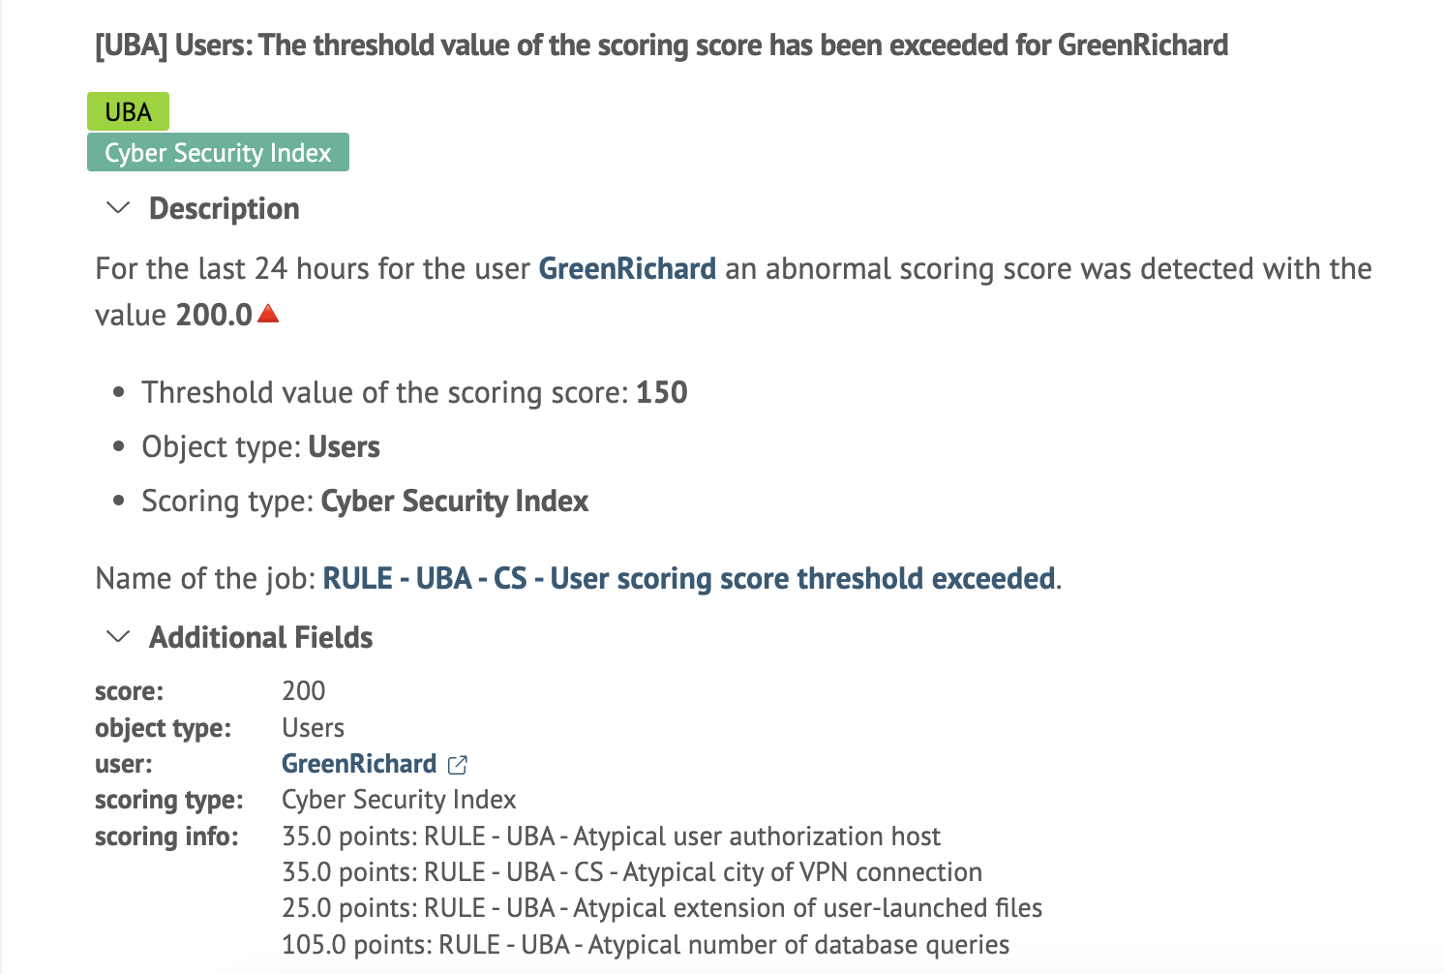
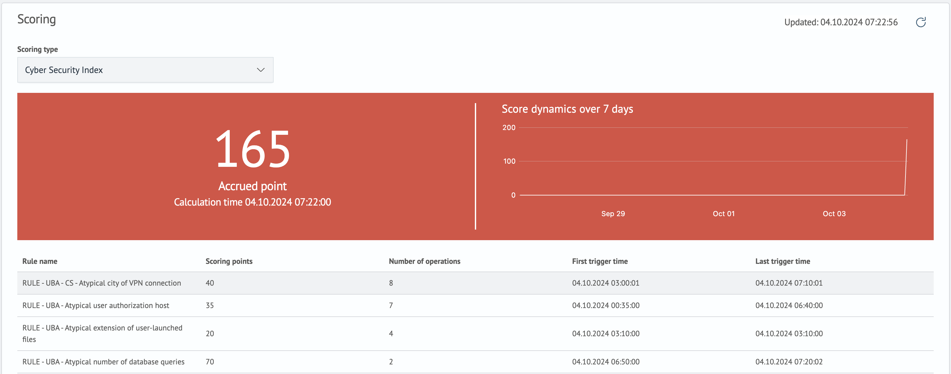
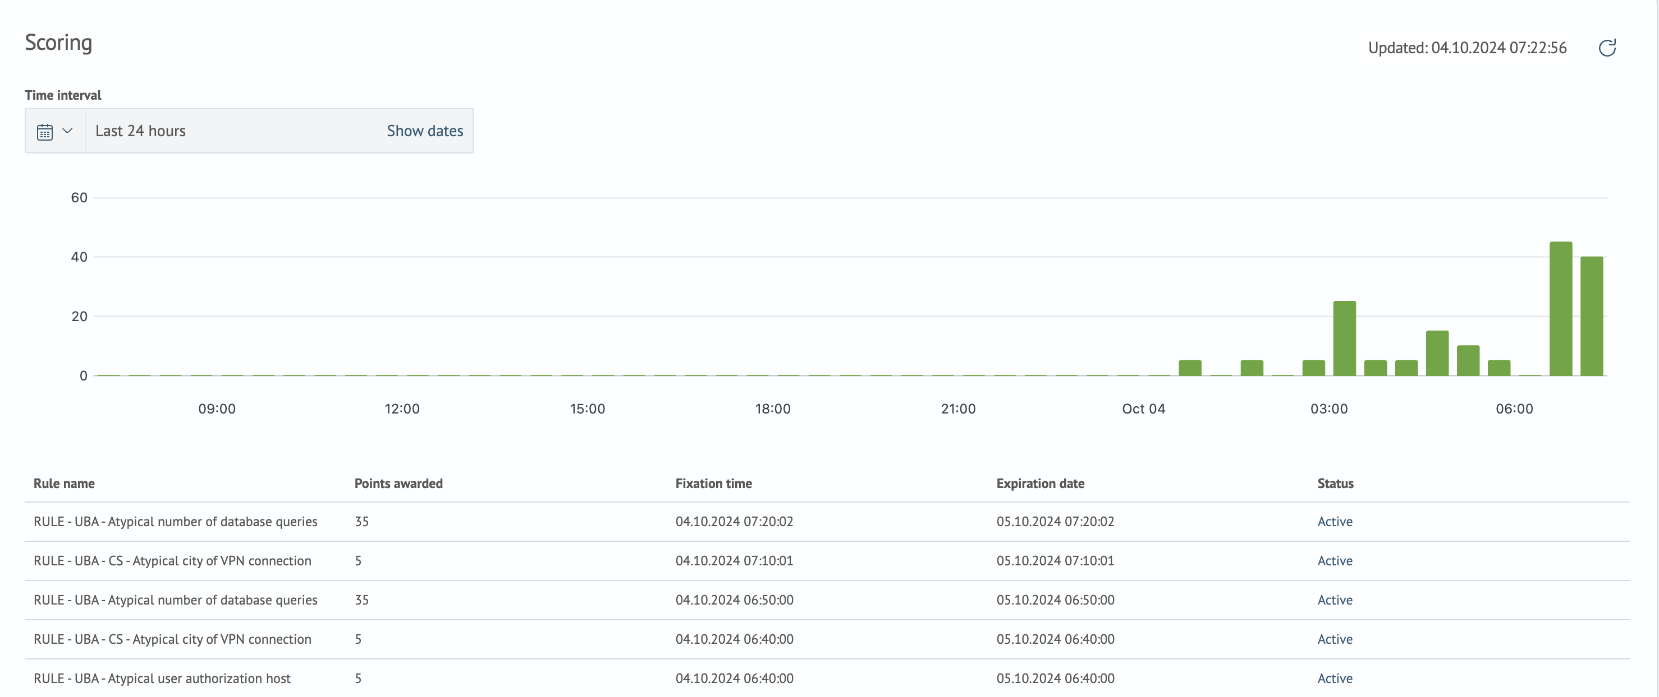
UBA: analysis and alerts
Object | Type | Category | Scoring Score
GreenRichard | user | Cybersecurity Index | 91
SanchezThomas | admin | Cybersecurity Index | 20
JohnSmith | user | Cybersecurity Index | 10
… | … | … | …
SAF-DSK-00324 | host | Cybersecurity Index | 5
incident generation
e-mail notification
functional dashboards

Slide 24
User Behavior Analytics module
Cybersecurity
Index
Operational
efficiency
Antifraud
…
Work
discipline
Monitoring
of VIP users
…

Slide 25
UBA: scoring categories
GreenRichard
user
5
15
Scoring Categories
10
Cybersecurity Index
25
35
5
5
Operational efficiency
10
15
15
…
65
10
Antifraud
5
10
10
Work discipline
5
5
20

Slide 26
Live demo

Slide 27
Thanks for your attention
Our contacts:
Follow us on LinkedIn
Schedule a demo

